Slide 1

Jane Mburu
Database Design for Daisy’s Dog Groomers

Slide 2
Objective
The goal of this assignment was to:
Design a comprehensive database for Daisy’s Dog Groomers to efficiently manage their business and operations.
Answer specific questions about the database to ensure it meets all client requirements.

Slide 3
Database Key Components
Owners Table
Dogs Table
Groomers Table
Appointment Table
Billing Table

Slide 4

Assignment 1: Codes
Create all the necessary tables according to the requirements and ER Diagram above.

Slide 5
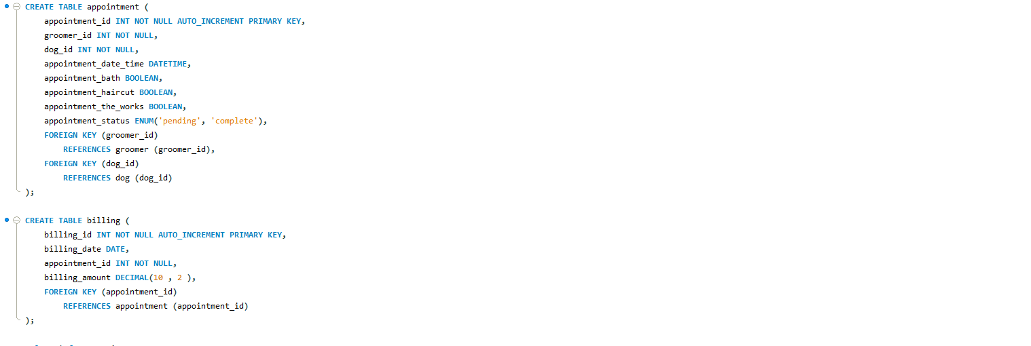
Assignment 1: Codes

Slide 6
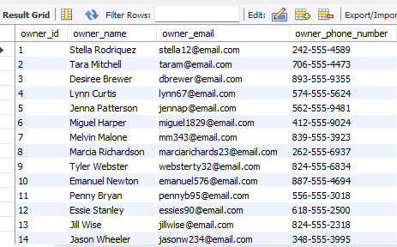
Assignment 2: Owner Table
Import the necessary data from the CSV files(dog.csv, grromer.csv, owner.csv, appointment.csv).

Slide 7
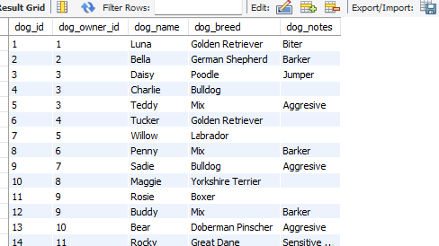
Assignment 2:Dog Table

Slide 8
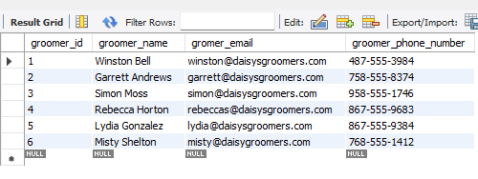
Assignment 2: Groomer Table

Slide 9
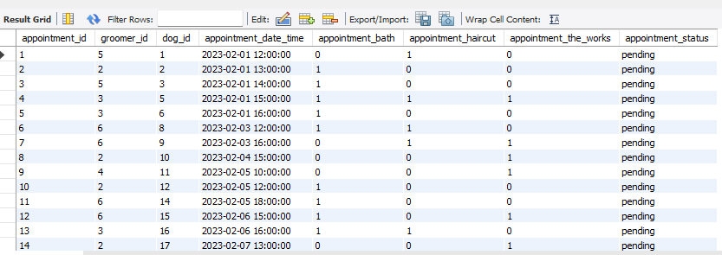
Assignment 2: Appointment Table

Slide 10
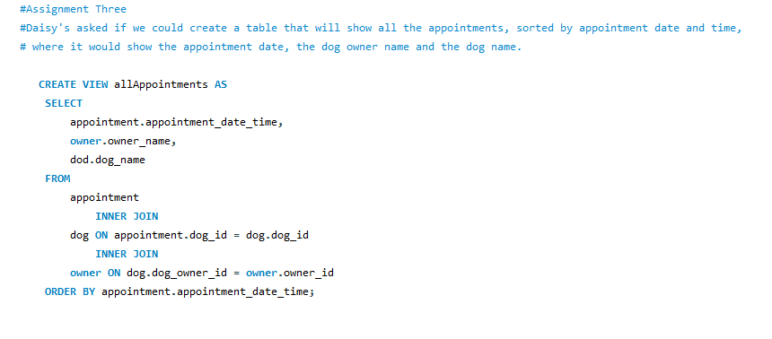
Assignment 3: Codes
Create a table that shows all the appointments, sorted by appointment date and time, showing the appointment date, the dog owner’s name, and the dog’s name.

Slide 11
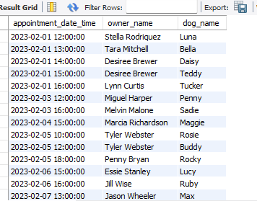
Assignment 3: Results

Slide 12
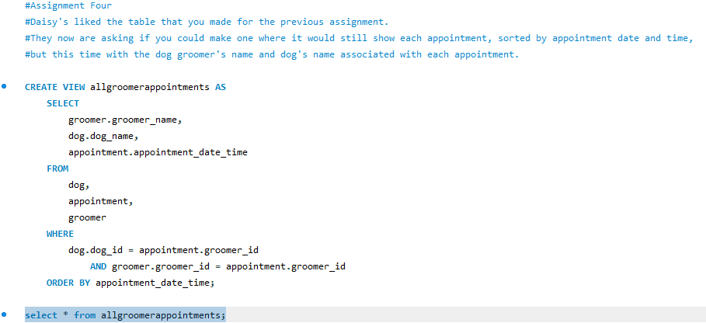
Assignment 4: Codes
Create a table that shows all the appointments, sorted by appointment date and time, showing the groomer’s name and the dog’s name

Slide 13
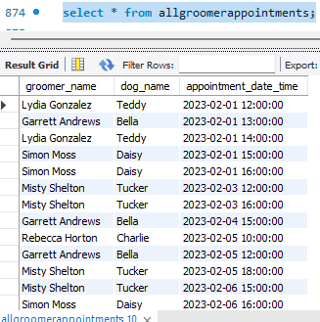
Assignment 4 Results

Slide 14
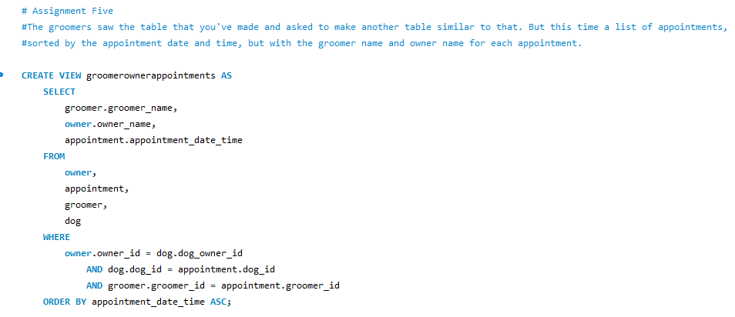
Assignment 5: Codes
Create a table a table that shows all the appointments, sorted by appointment date and time, showing the groomer’s name, and the dog’s owner’s name.

Slide 15
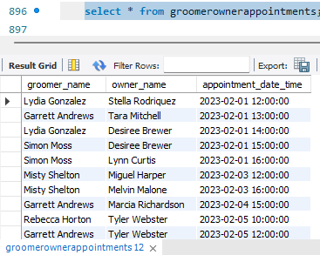
Assignment 5 Results

Slide 16
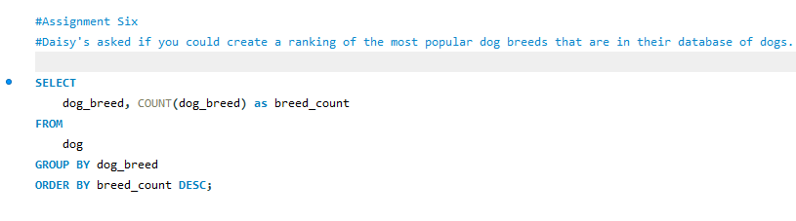
Assignment 6: Codes
Create a ranking of the most popular dog breeds that are in the database of dogs.

Slide 17
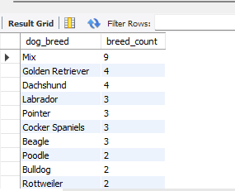
Assignment 6: Results

Slide 18
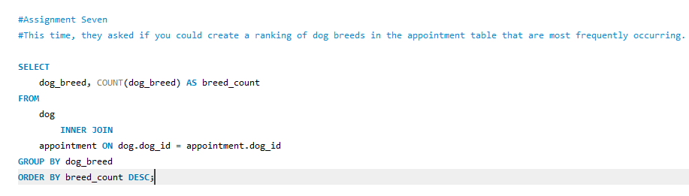
Assignment 7: Codes
Create a ranking of dog breeds in the appointment table that are most frequent.

Slide 19
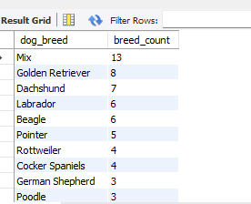
Assignment 7: Results

Slide 20
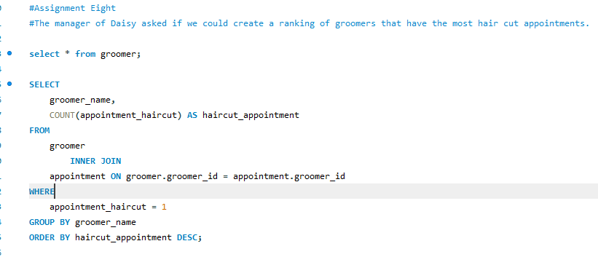
Assignment 8: Codes
Create a ranking of groomers that have the most haircut appointments

Slide 21
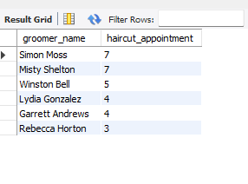
Assignment 8: Results

Slide 22
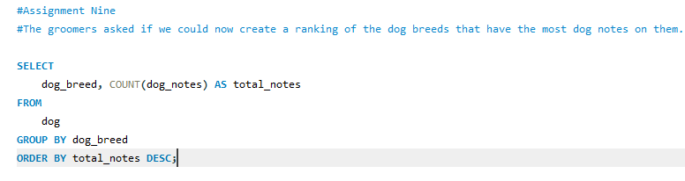
Assignment 9: Codes
Create a ranking of the dog breeds that have the most dog notes on them

Slide 23
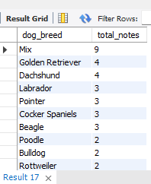
Assignment 9: Results

Slide 24
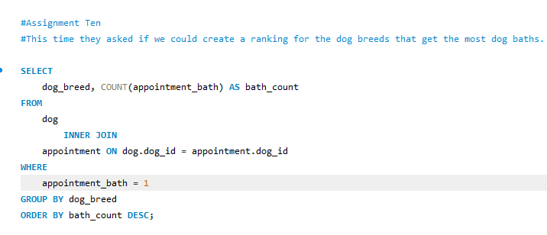
Assignment 10: Codes
Create a ranking for the dog breeds that get the most dog baths.

Slide 25
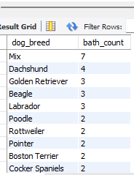
Assignment 10: Results

Slide 26
Conclusion
Through this assignment, I:
Successfully designed and implemented a comprehensive database for Daisy’s Dog Groomers.
Efficiently managed data import from CSV files.
Created detailed tables, views, and rankings to meet specific client requirements.

Slide 27
Benefits of the Database
Streamlined business operations and improved data management.
Enhanced client and appointment tracking.
Provided valuable insights through data analysis and rankings.

